Slide 1
Genetic Condition Cause Prediction with Large Language Models
Notes:
Hi everyone!

Slide 2
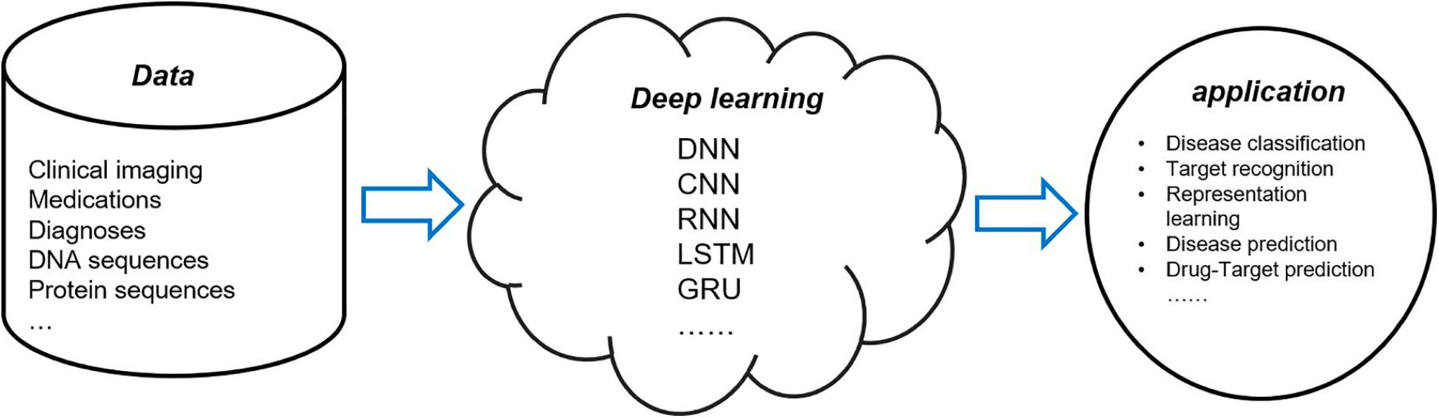
Motivation - Why Cause Prediction?
Higher accuracy in diagnosis
Open doors to more personalized medicine
Figure 1. Applications of Deep Learning in Computational Medicine
Notes:
In this project, we aim to predict the causes of a genetic condition based on its MedlinePlus description (which we use as a proxy for patient medical history data).
Understanding disease causes leads to better pattern identification and earlier detection, resulting in more accurate diagnoses and better treatment outcomes. It can also advance personalized medicine by identifying common risk factors and symptoms, leading to more targeted prevention and treatment strategies.
https://www.frontiersin.org/articles/10.3389/fgene.2021.607471/full
https://arxiv.org/pdf/1810.04805.pdf

Slide 3
Research Question
Given the description of a genetic condition, can we correctly choose which causes go with the disease?
Notes:
Given the description, can we correctly choose which causes go with the disease?

Slide 4

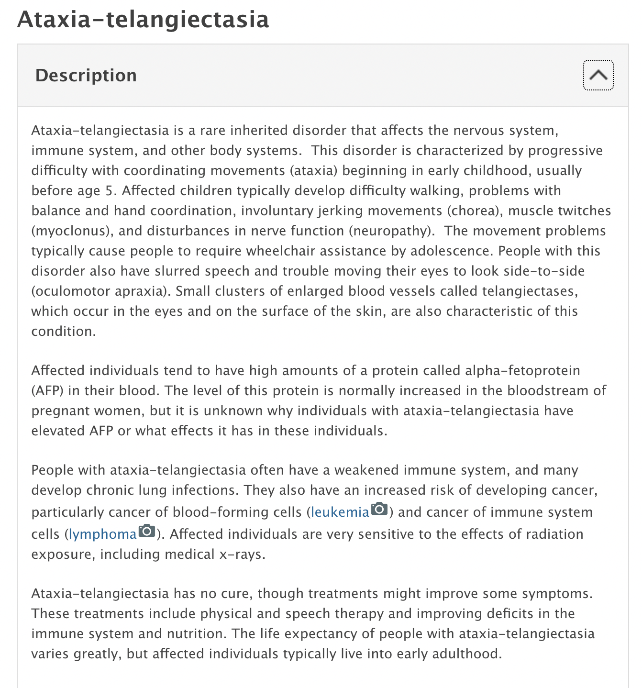
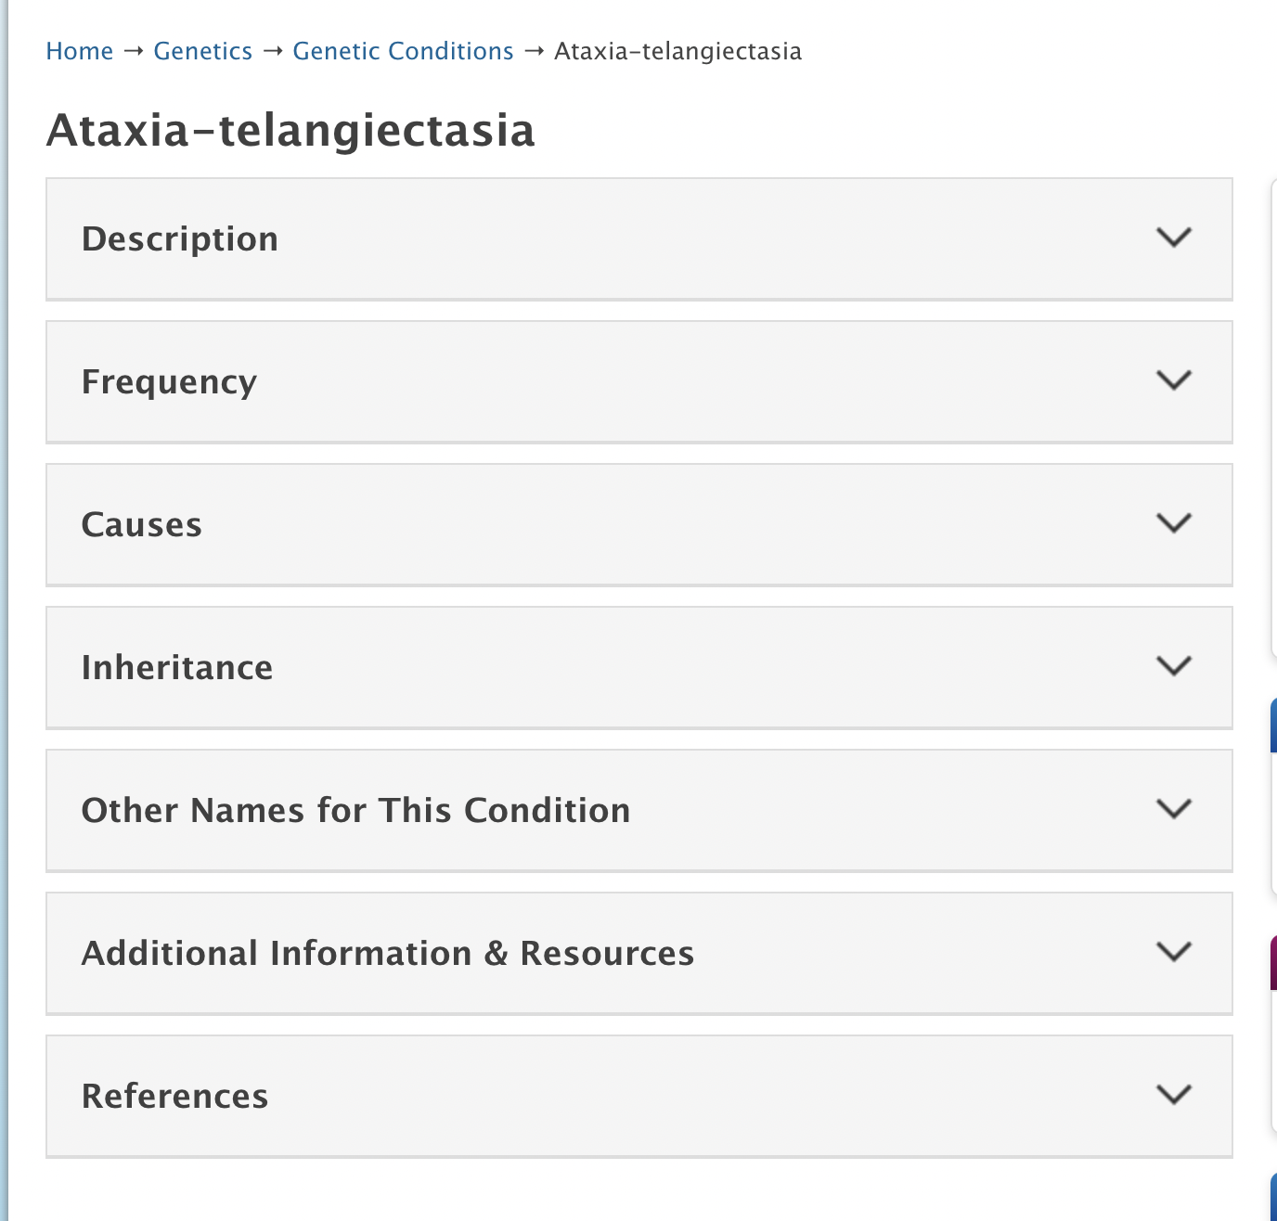
Data
Scraped 326 genetic conditions from medlineplus.gov
Genetic Condition Page Example
Description Field in Genetic Condition Page
Notes:
We got our data from MedlinePlus, an online health information resource run by the NIH. We went into each genetic condition listed in the Genetic Conditions page, and scraped their description, frequency, causes, and inheritance data. Here you can see what the genetic condition page looks like and an example of an expanded description box.

Slide 5
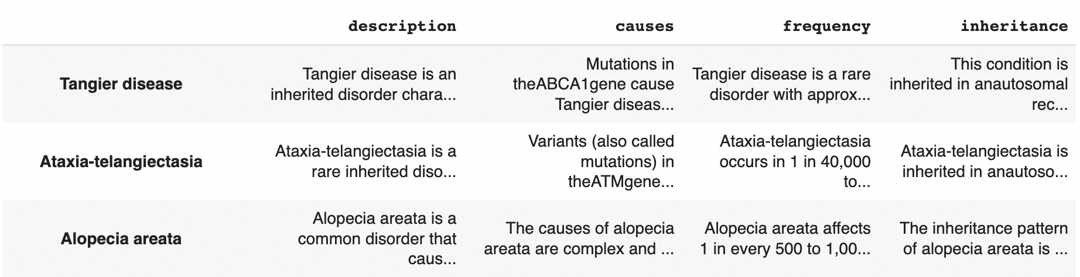
Data Cleaning
Removed irrelevant rows
Removed “causes”, “frequency”, “inheritance” prefix from every observation
Removed null observations
Dataframe
Notes:
For cleaning, we removed irrelevant rows that did not have genetic condition info, removed “causes”, “frequency”, “inheritance” prefix from every observation, and removed null observations

Slide 6
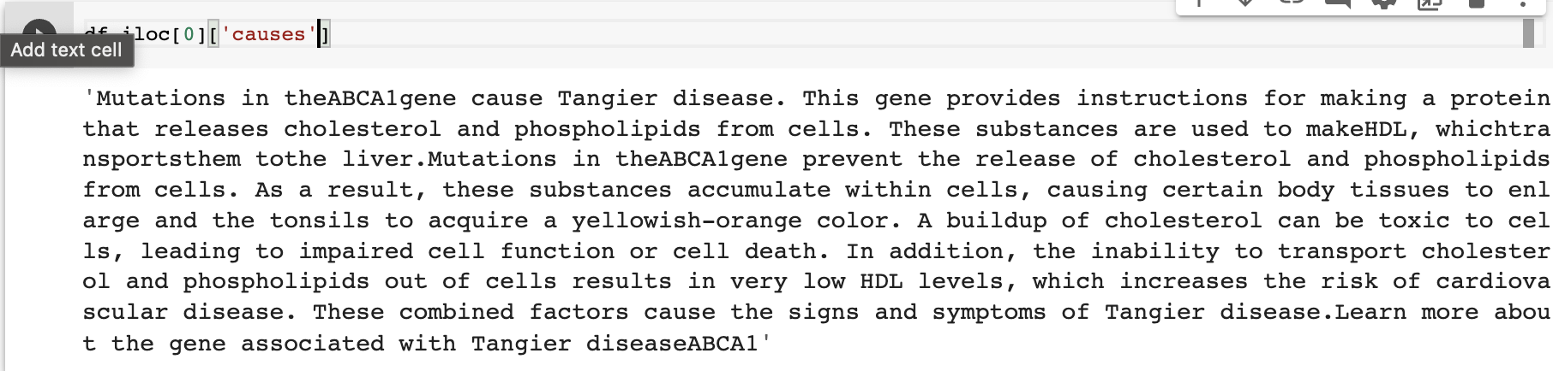
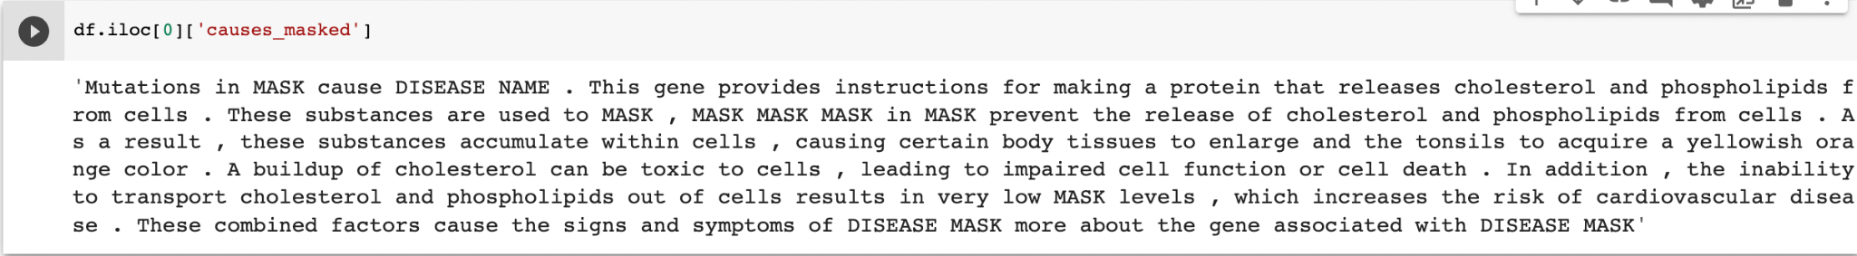
Masking
Unmasked Disease Cause Example
Masked Disease Cause Example
Notes:
Will!!!!
We also perform masking so that we can meaningfully evaluate how well our model is performing. Without masking out things like disease names and gene names, our model could just match those rare terms and get 100% accuracy.

Slide 7
Data Exploration - Term Frequency
LLMs have a fixed vocabulary size
Can see if top words are in vocab
Identification of medical terms that need to be added to the vocab or fine-tuned
Notes:
Large language models have fixed vocabulary sizes, typically around 30,000 to 50,000 words. By looking at the top 50 words in a corpus, we can get a sense of how many of those words are already in our LLM's vocabulary - there may be medicine-specific words or phrases that aren’t well-represented in the vocabulary, which may call for expanding the vocabulary or fine-tuning the model to better handle those words.

Slide 8
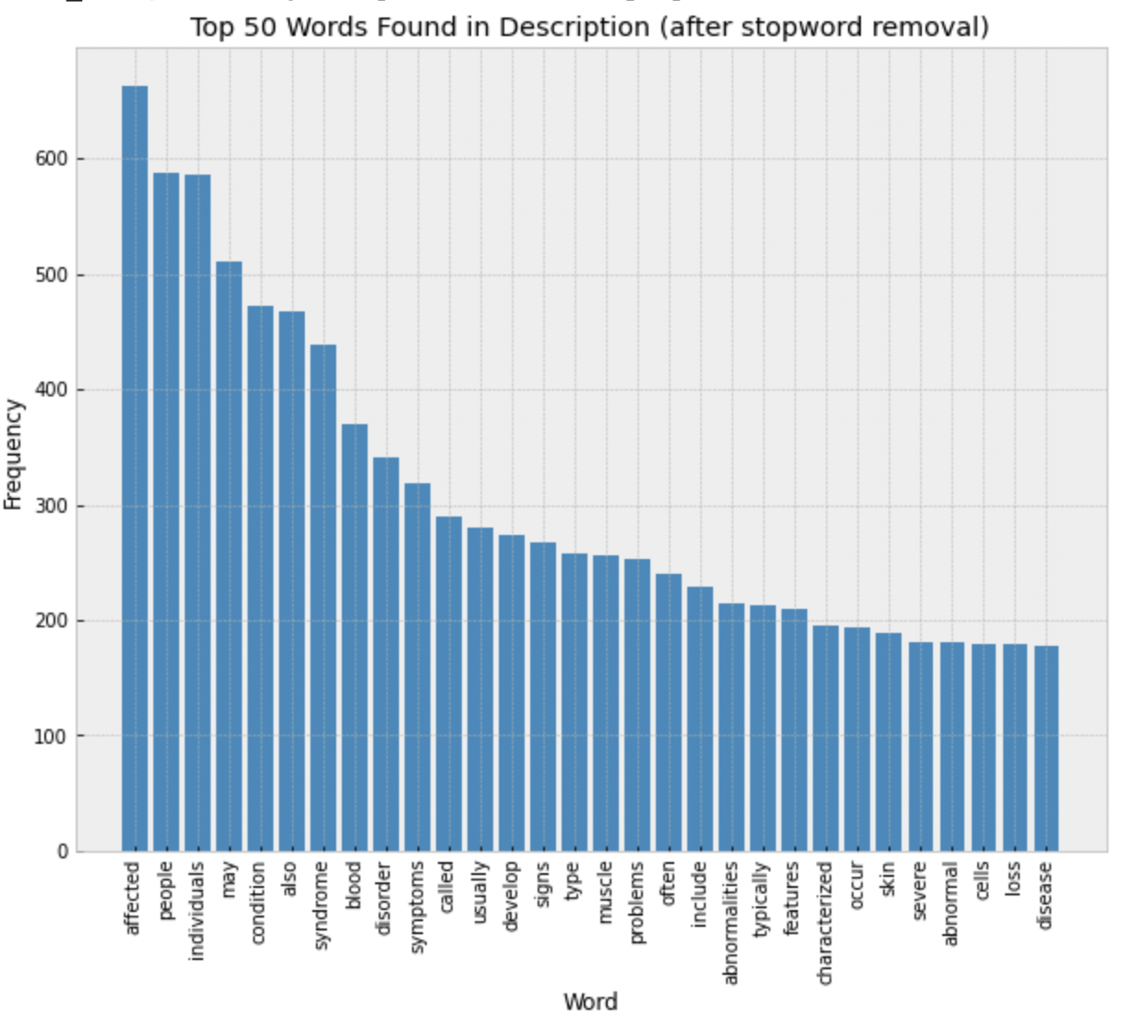
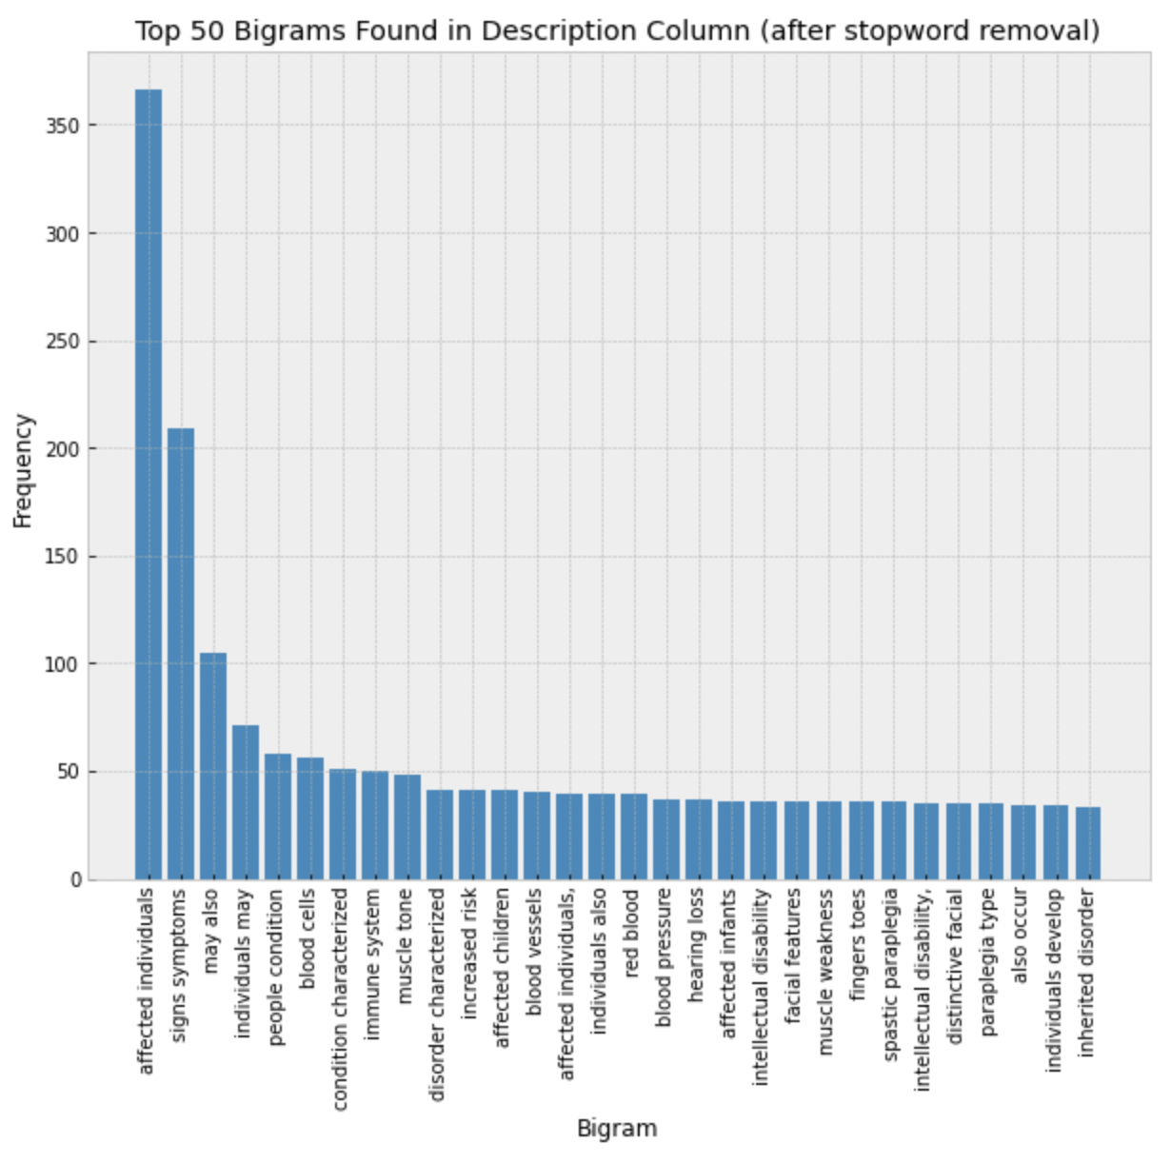
Term/Bigram Frequency
Notes:
We can see that the top words include "affected", "people", and "individuals". It's not surprising that most are medical terminology such as "syndrome", "symptoms", "muscle", etc.
These are the top bigrams that occur in the description after stopword removal. We can observe common language patterns in this medical data - "cells" frequently comes after "blood", "symptoms comes after "signs", etc.

Slide 9

Embedding Language
Figure 14. Illustration of Word Embeddings
Notes:
Before we can run our text through some ML models, we need to encode it somehow. The goal of embedding language is to create high-dimensional vectors called embeddings where things that mean the same thing are close to each other. For this project we use the sentence embedding model called MPNET which can model sentence meanings with state of the art accuracy.

Slide 10
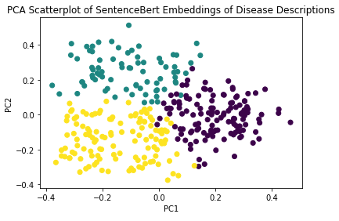
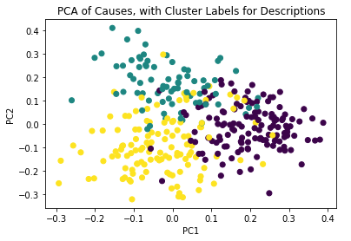
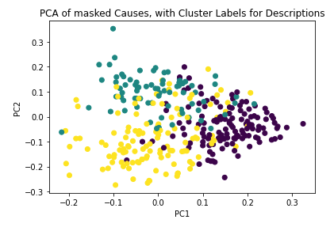
PCA Scatterplots of Embeddings
Figure 6. SentenceBert Embeddings of Disease Descriptions PCA Scatterplot
Figure 7. Causes with Cluster Labels for Descriptions PCA Scatterplot
Figure 8. Masked Causes with Cluster Labels for Descriptions PCA Scatterplot
Notes:
To explore what our data looks like in the embedding space, we plotted out our sentence embeddings. We colored the plots with cluster labels for the “description” embeddings. What we see when we plot the embeddings of the causes texts is that the same examples stay in the same part of the embedding space, although there there is a bit more overlap. Looking at these plots suggests that we can pair causes and descriptions with semantic similarity.

Slide 11
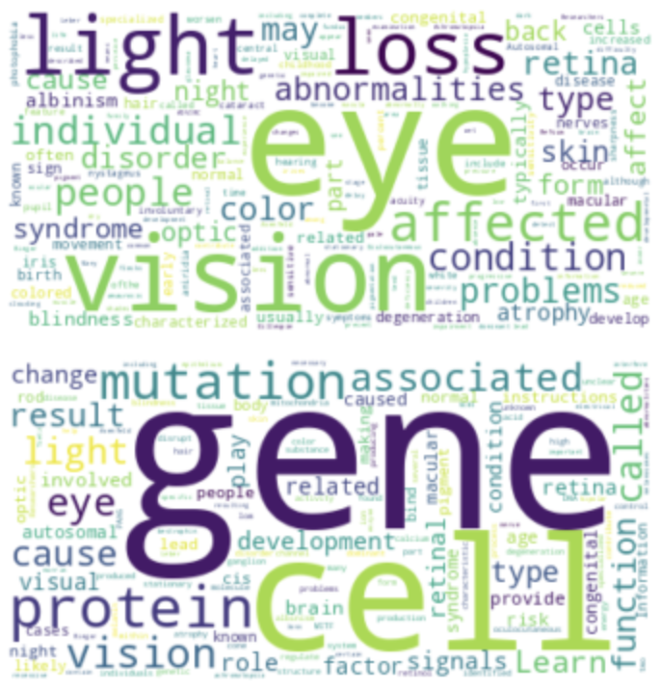
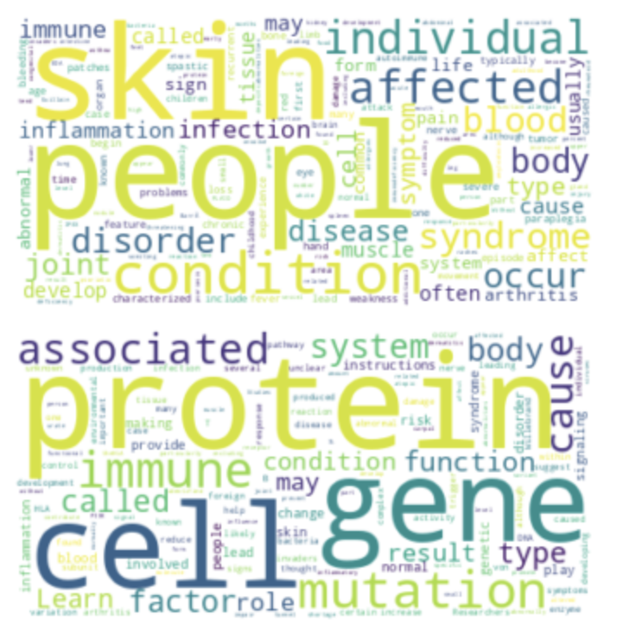
Semantic Cluster Word Clouds
Figure 9. Word Cloud of First Cluster
Figure 10. Word Cloud of Second Cluster
Notes:
We also generated word clouds to get an idea of the semantic meaning of our clusters. On the top we see word clouds for description clusters, and on the bottom we see them for causes. We clearly see that one cluster pertains to diseases that affect vision, while the other cluster seems to be about skin conditions. We found that the corresponding causes clusters were dominated by generic words like protein, gene, and mutation, and were less meaningful.

Slide 12
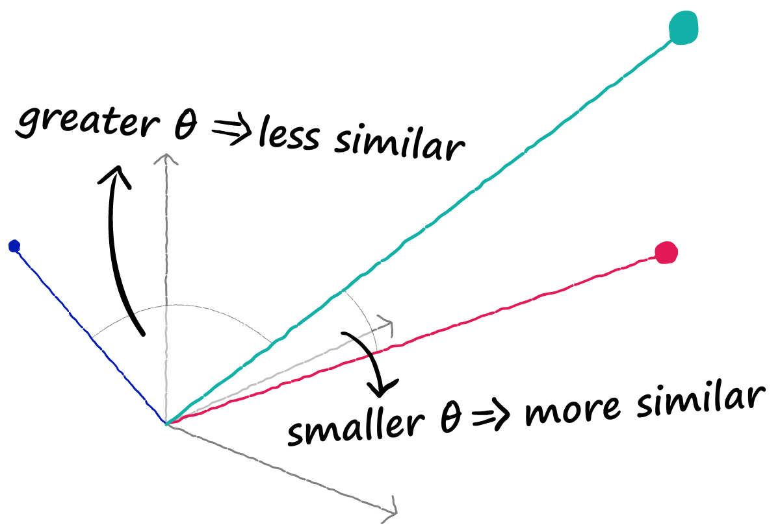
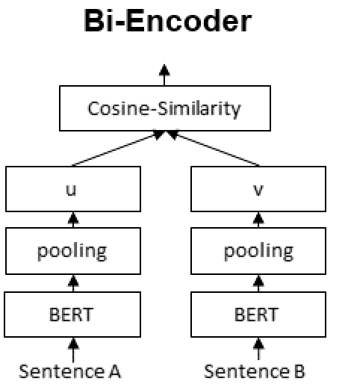
MPNET Bi-encoder Matching
Cosine Similarity
Notes:
In order to match descriptions and causes we use a bi-encoder.. The bi-encoder simply measures the similarity of the embeddings, and we say that the two most similar passages belong to each other.

Slide 13
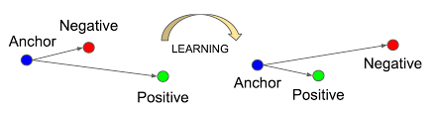
Simple Contrastive Learning
Built “causes_relation” vector
Shifted description embedding by this relation vector
Contrastive learning + PCA improves n-grams as well
Resulted in ~3.5% boost in accuracy!!!
Figure 18. Contrastive Learning Illustration
Notes:
In addition we used contrastive learning in order to model the relationship between the causes and the descriptions. We built this relationship by subtracting out the average embedding of the causes from the average embedding description. Subtracting out this relationship vector from the description embeddings before evaluating semantic similarity gave us 3.5% boost in accuracy.

Slide 14
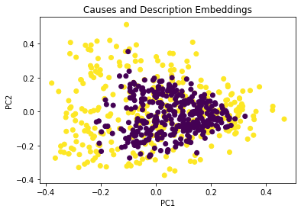
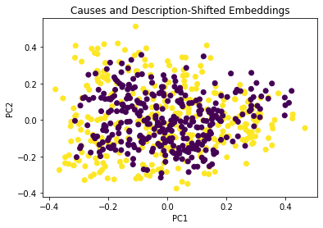

Contrastive Learning Visualized
Notes:
Here we can see who contrastive learning looked like for our data. The first plot shows our causes embeddings in purple and our description embeddings in yellow. Interestingly, they seem to have the same distribution except that the description embeddings are farther apart. When we add in the learned relation, the distributions now have about the same size.
What’s really cool about this is that we performed actually a “shift” in the high dimensional embedding space since we were adding a vector, which somehow corresponded to accurately scaling the distribution in the 2-dimensional representation.

Slide 15
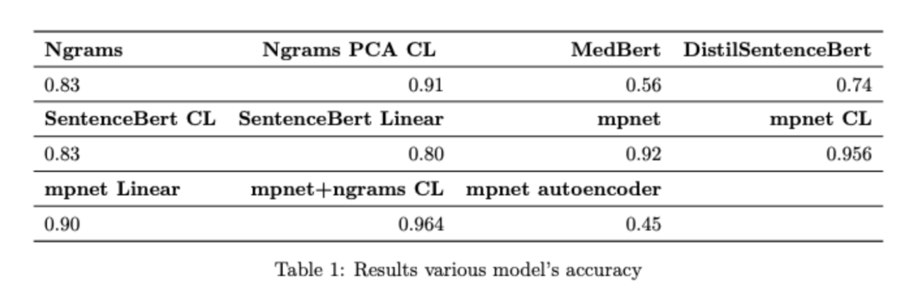
Results
Notes:
Here are our results for accuracy over a binary classification task where classify whether a pair belong to each other. We used Ngrams as a baseline which worked pretty well. Our best results were with MPNET adjusted with contrastive learning and our ensemble model where we used both mpnet embeddings and ngrams as input features.

Slide 16
Thanks!
Any questions?

Slide 17
References
Devlin, J., Chang, M., Lee, K., & Toutanova, K. (2018). BERT: Pre-training of Deep Bidirectional Transformers for Language Understanding. Retrieved 22 March 2023, from https://arxiv.org/abs/1810.04805
Yang, S., Zhu, F., Ling, X., Liu, Q., & Zhao, P. (2021). Intelligent Health Care: Applications of Deep Learning in Computational Medicine. Frontiers In Genetics, 12. doi: 10.3389/fgene.2021.607471
MedlinePlus: Genetic Conditions. (2023). Retrieved 22 March 2023, from https://medlineplus.gov/genetics/conditions
Cross-Encoders — Sentence-Transformers documentation. (2023). Retrieved 22 March 2023, from https://www.sbert.net/examples/applications/cross-encoder/README.html

